Slide 1

Game Theory III
HE3001, Microeconomics 3 Nanyang Technological University

Slide 2
Recap
Last week, we looked at how to represent sequential games.
Extensive Form
Information Sets
Identifying all strategies
These are important for how likely outcomes of these sequential games will be analysed.
Later on, we will look at a special case of sequential games: repeated games.

Slide 3
Sequential Games with and without perfect information

Slide 4
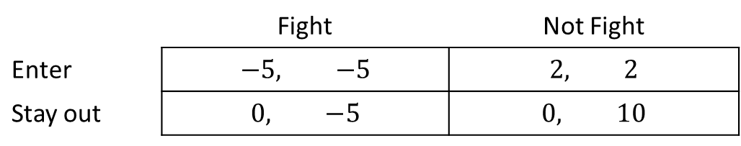
Sequential Game of Entry (Imperfect Information)
An Entrant decides whether to enter a market. An Incumbent decides whether to fight or not. (Fighting can be taken to be some form of taking competitive action, say by raising output beyond standard levels.)
Suppose that there is imperfect information: the incumbent cannot observe the Entrant’s decision before making his decision. This is equivalent to a static game because it is as if they move simultaneously.
The payoffs for each possible outcome are given by the payoff matrix:
Incumbent
 | Fight | Not Fight
Enter | $$−5, −5$$ | $$2, 2$$
Stay out | $$0, −5$$ | $$0, 10$$
Entrant

Slide 5
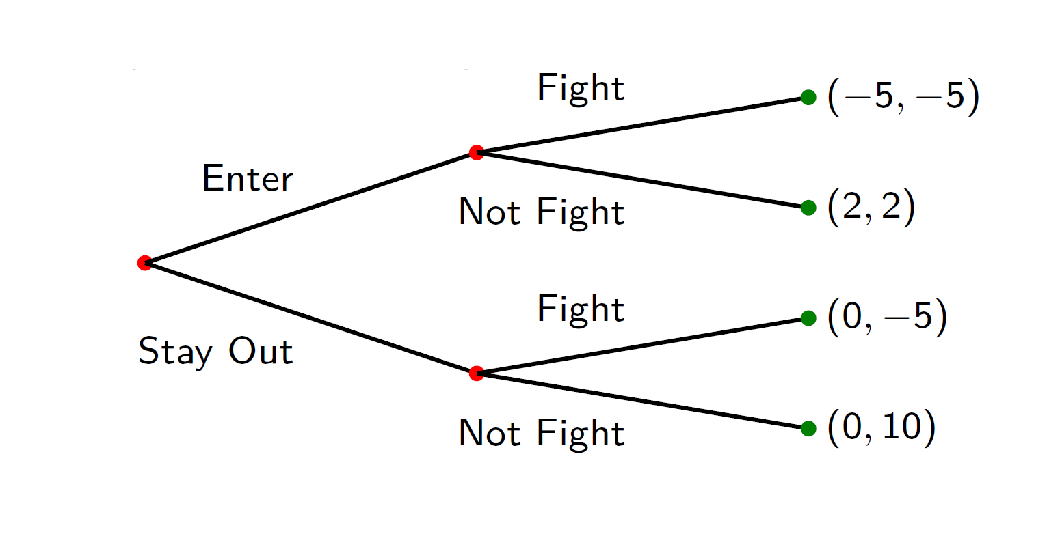
Extensive Form (Imperfect Information)
The line connecting the nodes after Enter and Stay Out tells us they are in the same information set: the incumbent cannot distinguish between these two nodes.
Entrant
Incumbent

Slide 6
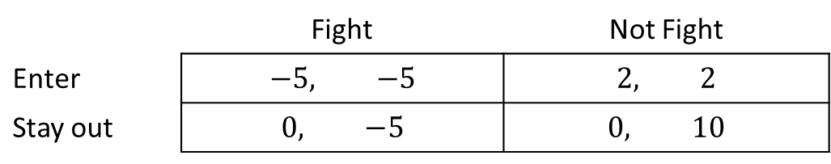
Normal Form (Imperfect Information)
The Incumbent and Entrant each have 2 possible choices of actions in the static game.
The normal form for the static game is just the same as the payoff matrix.
Incumbent
 | Fight | Not Fight
Enter | $$−5, −5$$ | $$2, 2$$
Stay out | $$0, −5$$ | $$0, 10$$
Entrant

Slide 7
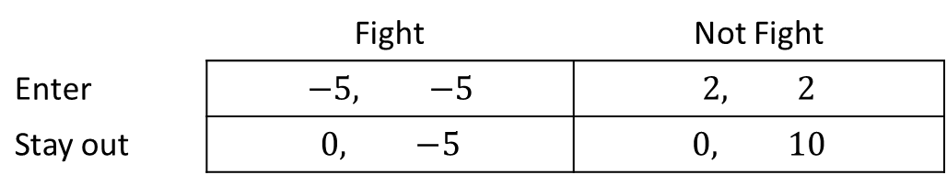
Sequential Game of Entry (Perfect Information)
An Entrant decides whether to enter a market. An Incumbent decides whether to fight or not.
Now, the first mover, Entrant makes his choice which is observed before the second mover, the Incumbent makes his move.
The payoffs for each possible outcome are again given by the following payoff matrix.
Incumbent
 | Fight | Not Fight
Enter | $$−5, −5$$ | $$2, 2$$
Stay out | $$0, −5$$ | $$0, 10$$
Entrant

Slide 8
Extensive Form (Perfect Information)
Entrant
Incumbent

Slide 9
Normal Form (Perfect Information)
The payoff matrix is not the normal form of the sequential game!
It masks the fact that the second mover can condition his action on the first movers’ action.
The incumbent’s strategy is actually a pair of actions: (X if Entrant enters, Y if Entrant does not enter)
The “correct” normal form with all pure strategy profiles:
Important because the incumbent’s strategy in each case will affect the best response of the entrant!
Incumbent
 | (F, F) | (F, NF) | (NF,F) | (NF,NF)
Enter | -5,-5 | -5,-5 | 2,2 | 2,2
Stay Out | 0,-5 | 0,10 | 0,-5 | 0,10
Entrant

Slide 10
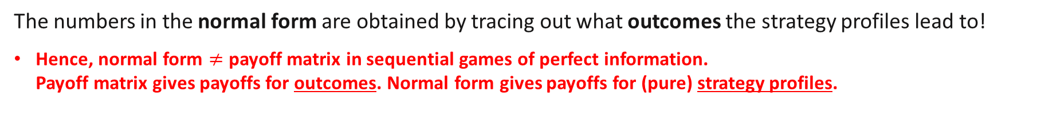
Normal Form (Perfect Information)
Recall that the second mover, the incumbent has actually 4 different (pure) strategies.
The incumbent’s strategy is actually a pair of actions: (What to do if Entrant enters, What to do if Entrant does not enter)
Extensive form:
Normal form:
Incumbent
 | (F, F) | (F, NF) | (NF,F) | (NF,NF)
Enter | -5,-5 | -5,-5 | 2,2 | 2,2
Stay Out | 0,-5 | 0,10 | 0,-5 | 0,10
Entrant
Incumbent
Entrant
The numbers in the normal form are obtained by tracing out what outcomes the strategy profiles lead to!
Hence, normal form $≠$ payoff matrix in sequential games of perfect information. Payoff matrix gives payoffs for outcomes. Normal form gives payoffs for (pure) strategy profiles.
Notes:
For static games which is equivalent to a sequential game with imperfect information, payoff matrix is the same as the normal form

Slide 11

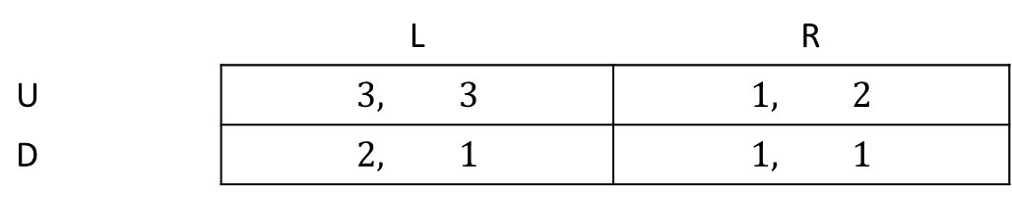
Review Question 1
Player 1 can first choose between U or D. After observing Player 1’s action, Player 2 can choose between L or R. The below payoff matrix gives the payoff for each outcome.
Fill in the entries A,B,C, D in the normal form below.
Player 2
 | L | R
U | $$3, 3$$ | $$1, 2$$
D | $$2, 1$$ | $$1, 1$$
Player 1
 | A: (L if U, R if D) | B: (R if U, L if D) | (R if U, R if D) | (L if U, L if D)
U | 3,3 | 1,2 | C: 1,2 | 3,3
D | 1,1 | 2,1 | D: 1,1 | 2,1

Slide 12
Nash Equilibria in Sequential Games of Perfect Information

Slide 13
Sequential Entry Game: Nash Equilibria
Incumbent
 | F, F | F, NF | NF,F | NF,NF
Enter | -5,-5 | -5,-5 | 2,2 | 2,2
Stay Out | 0,-5 | 0,10 | 0,-5 | 0,10
Entrant
There are three pure strategy NE: {Enter, (NF,F)} ; {Enter, (NF,NF)}; and {Out; (F,NF)}.
However, do all of them make sense?

Slide 14
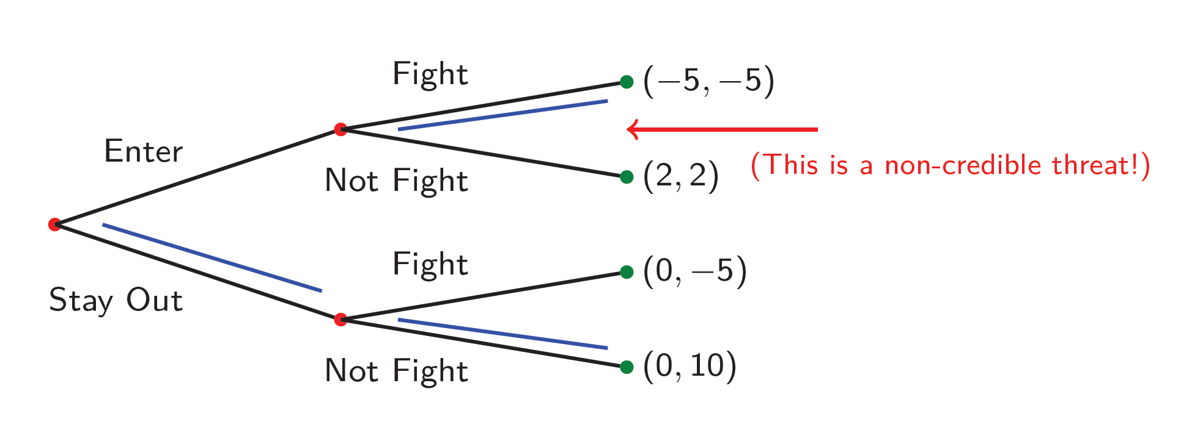
Sequential Entry Game {Out; (F,NF)}
Intuitively, in this NE, the incumbent is planning a more aggressive marketing stance (fight) if the first mover enters. Anticipating this, the entrant chooses to stay out…
But, IF the entrant actually enters, the incumbent will earn more if he does not fight.
Fighting if the first mover enters is not really a best response! Not rational for the entrant to believe that the incumbent will do this.
Entrant
Incumbent

Slide 15
Sequential Entry Game {Out; (F,NF)}
Why is “threatening” to fight if the entrant enters a “best response” in the NE? Fixing the entrant’s strategy at Out, the incumbent’s payoffs do not depend on his choice for the case where entrant enters! (Entering is “off the equilibrium path”)
Incumbent
 | (F, F) | (F, NF) | (NF,F) | (NF,NF)
Enter | -5,-5 | -5,-5 | 2,2 | 2,2
Stay Out | 0,-5 | 0,10 | 0,-5 | 0,10
Entrant
Entrant
Incumbent
Suppose Entrant chooses to Stay Out and Incumbent changes strategy for if Entrant Enters, Incumbent’s payoff does not change.
The mathematical definition of a NE is what leads to these kinds of NE. We hence need a stronger equilibrium notion than NE to rule out these kinds of cases!
Notes:
The strategy that matters for the incumbent is only the one involving his strategy on the equilibrium path.

Slide 16
Subgame Perfect Nash Equilibria in Sequential Games of Perfect Information

Slide 17
Refining our set of NE..
Nash equilibria did not rule out non-credible threats, so we need a refinement...
Even if choices are for a case which is off the equilibrium path, we are going to assume hypothetically that the case will be reached so that choices will matter for payoffs.
Can be done by backward induction.
This deals with the problem where parts of a strategy for cases which are not reached do not
actually matter for their consequent payoffs.

Slide 18
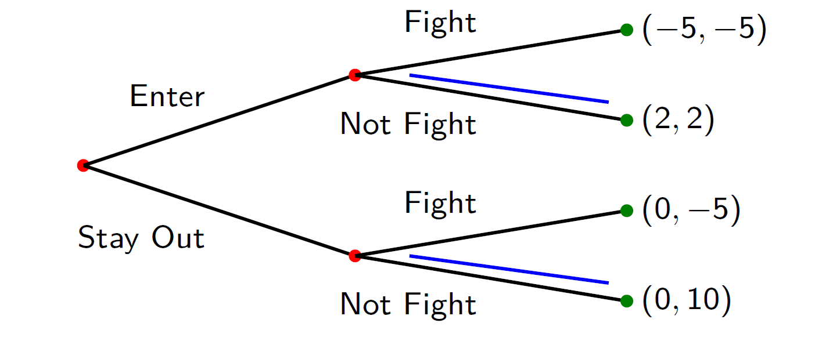
Refining our set of NE..
Case 1: IF Entrant Enters
The best response of the incumbent is not to fight. The entrant then gets a payoff of 2.
Case 1
Entrant
Incumbent

Slide 19
Refining our set of NE..
Case 2: IF Entrant Stays Out
The best response of the incumbent is not to fight. The entrant then gets a payoff of 0.
Entrant
Incumbent
Case 2

Slide 20
Refining our set of NE..
Given the Incumbent’s strategy in Cases 1 and 2, it is hence a best response for the entrant to actually enter and get a payoff of 2 versus a payoff of 0.
Entrant
Incumbent

Slide 21
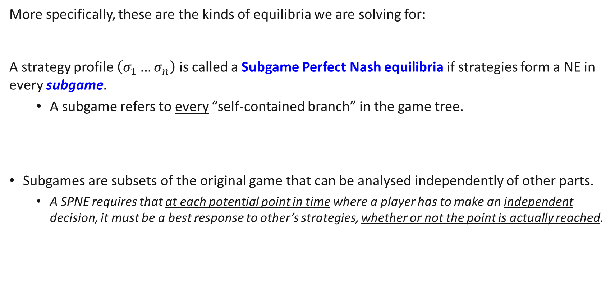
Subgame Perfect Nash Equilibria
More specifically, these are the kinds of equilibria we are solving for:
A strategy profile $\left(σ_{1}…σ_{n}\right)$ is called a Subgame Perfect Nash equilibria if strategies form a NE in every subgame.
A subgame refers to every “self-contained branch” in the game tree.
Subgames are subsets of the original game that can be analysed independently of other parts.
A SPNE requires that at each potential point in time where a player has to make an independent decision, it must be a best response to other’s strategies, whether or not the point is actually reached.
Notes:
This deals with the problem where parts of a strategy for cases which are not reached do not actually matter for their consequent payoffs.

Slide 22
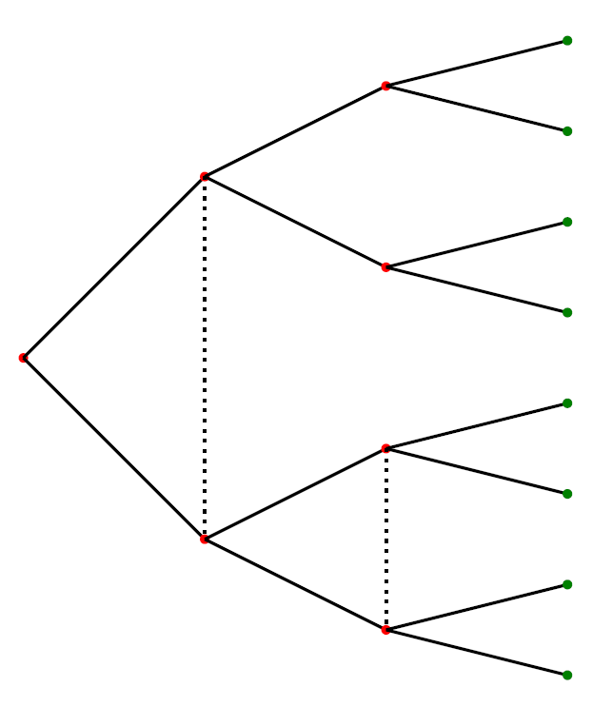
Identifying Subgames (Example)
A “branch” refers to a decision node and all its successors.
Several examples of branches are highlighted in yellow on the left.

Slide 23
Identifying Subgames (Example)
The top two branches are self contained.
The bottom branches are not self contained due to the information set (dotted line) connecting it other nodes outside the branch.
Only self-contained branches are subgames.
If an information set connects them to nodes outside the branch, the branch cannot be considered as an independent game! (Because decision nodes in an information set must be considered together)

Slide 24
Identifying Subgames (Example)
There are a total of 3 subgames:
Two proper subgames involving branches, and 1 subgame involving the entire game.

Slide 25
Relationship between SPNE and NE
The overall game tree itself is always a subgame: it is a self-contained branch.
NE are strategy profiles which are NE of this “overall branch”.
From the definition of the SPNE, we require strategies to be NE in all subgames:
The overall subgame (I.e. the overall branch) AND
The proper subgames (I.e. other self-contained sub-branches)
This means that the set of Subgame Perfect Nash Equilibria is a subset of the set of Nash Equilibria. (All SPNE are NE, but not vice versa)

Slide 26
Finding Subgame Perfect Nash Equilibria
Pure strategy SPNE can be easily found using backward induction.
Identify all the proper subgames.
Start from the last subgames and solve for each of its NE. (Select a NE if not unique.)
Move to the subgame that is one step before and solve for the NE while taking into account the NE in the latter subgame. (Select a NE if not unique)
Repeat the process until we reach the initial node.
These steps will identify the strategies which lead to NE in all subgames!
Earlier players believe that later players, observing the strategy played, will best respond.

Slide 27
Sequential Entry Game: SPNE
By backward induction, we got the best responses for the incumbent in the sub-branches and then get the best response for the Entrant in the overall branch.
Subgame 1
Entrant
Incumbent
Subgame 2
Overall Subgame

Slide 28
Sequential Entry Game: SPNE
The unique Subgame Perfect Nash Equilibrium here is given by these set of strategies
Entrant: Enter
Incumbent: Do not fight if entrant enters, Do not fight if entrant stays out.
The associated SPNE outcome is (Enter, Do not fight) with a payoff of (2,2).
This example here is related to a class of games called commitment games.
The added concept of Subgame Perfection is required to filter out Nash Equilibria which cannot be committed to!

Slide 29
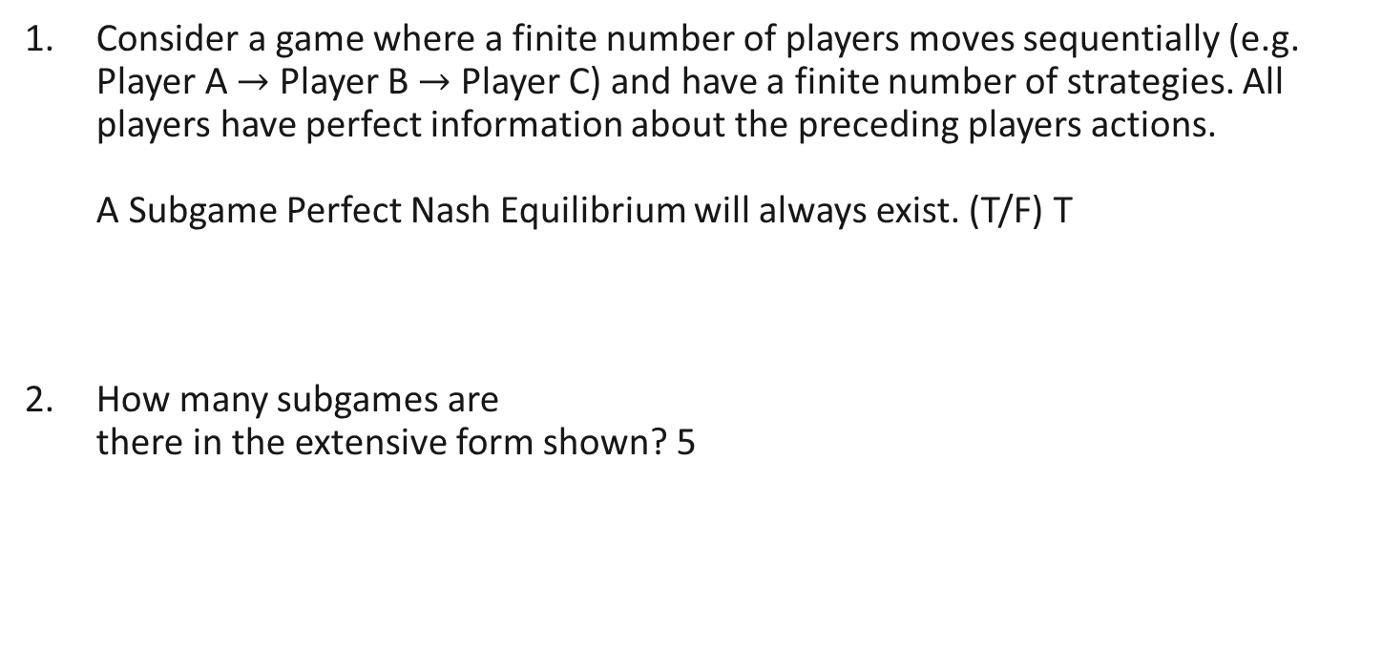
Review Questions 2
Consider a game where a finite number of players moves sequentially (e.g. Player A $→$ Player B $→$ Player C) and have a finite number of strategies. All players have perfect information about the preceding players actions. A Subgame Perfect Nash Equilibrium will always exist. (T/F) T
How many subgames are there in the extensive form shown? 5

Slide 30
Other kinds of sequential games..

Slide 31



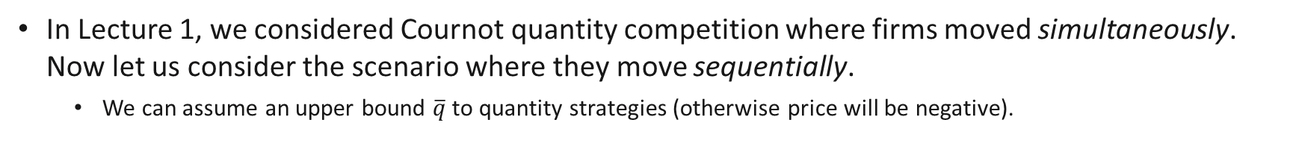



Example: Stackelberg Cournot Competition
In Lecture 1, we considered Cournot quantity competition where firms moved simultaneously. Now let us consider the scenario where they move sequentially.
We can assume an upper bound $\overline{q}$ to quantity strategies (otherwise price will be negative).
$$P\left(Q\right)=a−b(q_{1}+q_{2})$$
$$q_{2}=0$$
$$q_{1}=0$$
$$q_{1}=q$$
$$q_{2}=\overline{q}$$
$$q_{1}=\overline{q}$$
Sketch of Extensive Form

Slide 32
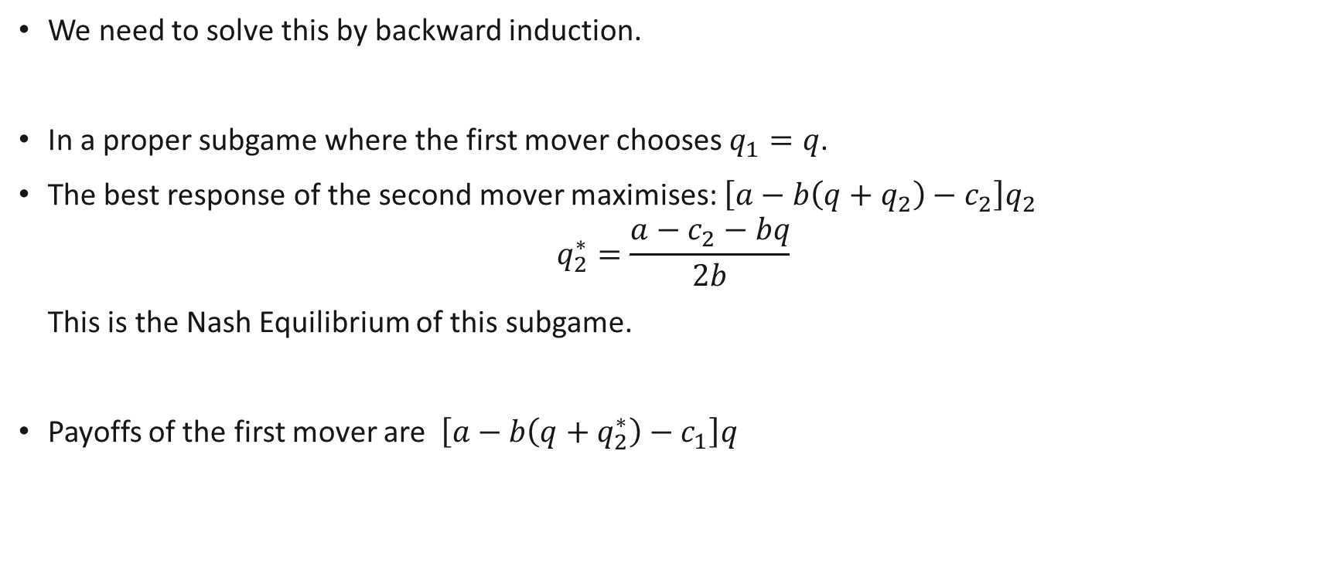
Example: Stackelberg Cournot Competition
We need to solve this by backward induction.
In a proper subgame where the first mover chooses $q_{1}=q$.
The best response of the second mover maximises: $\left[a−b\left(q+q_{2}\right)−c_{2}\right]q_{2}$
$$q_{2}^{∗}=\frac{a−c_{2}−bq}{2b}$$ This is the Nash Equilibrium of this subgame.
Payoffs of the first mover are $\left[a−b\left(q+q_{2}^{∗}\right)−c_{1}\right]q$

Slide 33
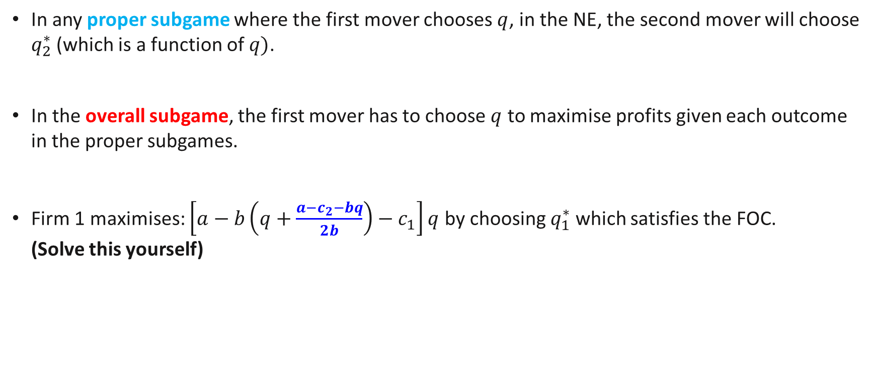
Example: Stackelberg Cournot Competition
In any proper subgame where the first mover chooses $q$, in the NE, the second mover will choose $q_{2}^{∗}$ (which is a function of $q)$.
In the overall subgame, the first mover has to choose $q$ to maximise profits given each outcome in the proper subgames.
Firm 1 maximises: $\left[a−b\left(q+\frac{a−c_{2}−bq}{2b}\right)−c_{1}\right]q$ by choosing $q_{1}^{∗}$ which satisfies the FOC. (Solve this yourself)

Slide 34
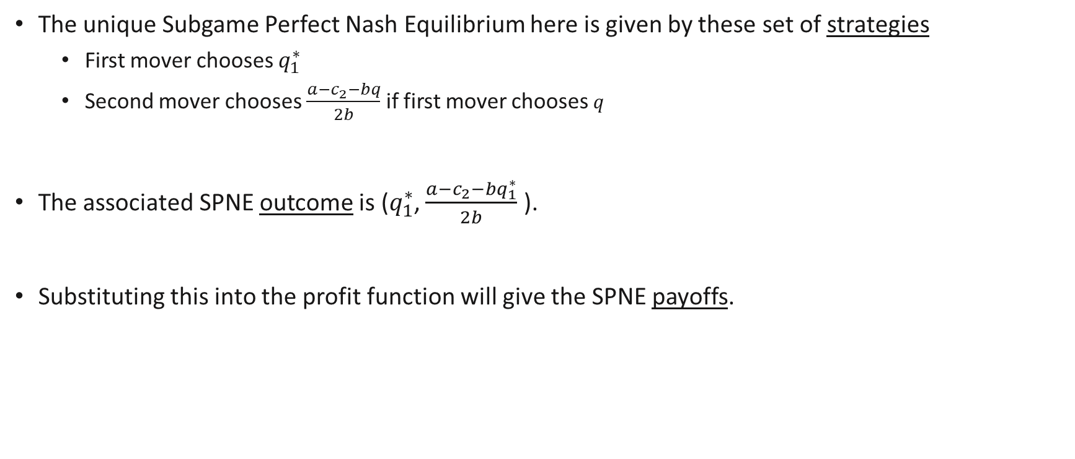
Stackelberg Cournot Competition (SPNE)
The unique Subgame Perfect Nash Equilibrium here is given by these set of strategies
First mover chooses $q_{1}^{∗}$
Second mover chooses $\frac{a−c_{2}−bq}{2b}$ if first mover chooses $q$
The associated SPNE outcome is ($q_{1}^{∗}$, $\frac{a−c_{2}−bq_{1}^{∗}}{2b}$ ).
Substituting this into the profit function will give the SPNE payoffs.

Slide 35
Example: “Hybrid” Sequential Games
Sometimes, a sequential game may involve a combination of multiple static games.
For example,
First stage could be a choice of what (static) game to play in the Second stage.
First stage could be static game A, Second stage could be static game B
(Perfect information in the sense that everyone observes the outcome of First stage before Second stage)
Such games can be analysed using the exact same methodology as for standard sequential games. (Backward induction and Subgame Perfect Equilibria)

Slide 36
Example 1
Suppose Player 1 can choose between Game A and Game B.
In each of these games, Players 1 and 2 have choose their strategy simultaneously.
They have two different actions they can choose (and randomize between).
U
1
U
D
2
Game A
D
U
1
D
1
1
L
Game B
L
R
2
R
1
L
R

Slide 37
Example 1: SPNE
Solve for the NE in each of Game A and Game B. The NE might not be unique.
Pick a NE for Game A and Game B if not unique. This is the NE we are choosing for the proper subgame.
Given this NE in Game A and Game B, Player 1 chooses the game which gives him a higher payoff.
2. and 3. form a possible SPNE. Notice that the SPNE might not be unique!
U
1
U
D
2
Game A
D
U
1
D
1
1
L
Game B
L
R
2
R
1
L
R

Slide 38
Example 2
Game B
Game A
Suppose Player 1 and 2 play game A, observe the outcome, and then play game B.
In each of these games, Players 1 and 2 have choose their strategy simultaneously.
2
L
U
L
R
1
R
2
L
2
R
U
2
L
D
L
R
1
1
R
2
L
R
2
L
U
L
R
1
D
R
2
L
2
R
2
L
D
L
R
1
R
2
L
R

Slide 39
Example 2: SPNE
Game B
Game A
Solve for the NE in Game B. The NE might not be unique.
For each of the subgames of Game B, pick a NE. Each of the subgames potentially has different payoffs (if no unique NE).
Pick a NE in the new game: Game A + payoffs
2. and 3. form a possible SPNE.
2
L
U
L
R
1
R
2
L
2
R
U
2
L
D
L
R
1
1
R
2
L
R
2
L
U
L
R
1
D
R
2
L
2
R
2
L
D
L
R
1
R
2
L
R

Slide 40
Review Question 3a
Consider the following extensive form game.
Highlight all the subgames in the extensive form. 3
Recall, a SPNE is found by performing backward induction on the extensive form game.
“There will always be a unique SPNE for this extensive form game.” True or False? F

Slide 41
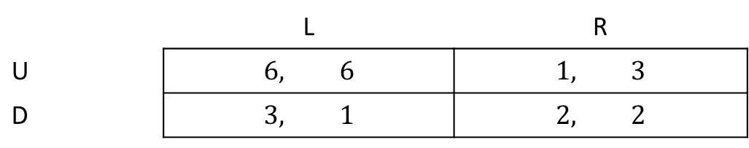
Review Question 3b
Player 1 can first choose between A or B. If he chooses A, the payoffs of Player 1 and 2 are (5,5). If he chooses B, Players 1 and 2 play a simultaneous game with the following payoff matrix.
Solve for all pure strategy SPNE.
Player 2
 | L | R
U | $$6, 6$$ | $$1, 3$$
D | $$3, 1$$ | $$2, 2$$
Player 1
Notes:
NE for simultaneous game: (U,L), (D,R), (0.25 U, 0.25L)
Last has payoff: 2 for each.

Slide 42
Repeated Games

Slide 43
Repeated Games
A strategic game is a repeated game if an identical stage game is played once in each of a number of periods.
Special case of hybrid sequential game: combination of multiple identical stage games.
With finite periods, can be represented in extensive form as a sequence of stage games.
Can be solved similar to Example 2 earlier.
An interesting case is the repeated Prisoner’s Dilemma, which if you recall had a unique “bad” NE.
We will not go into too much detail, but will discuss the general outcomes.
The potential outcomes of the game depend greatly on whether there are
a finite number of periods, or an infinite number of periods.

Slide 44
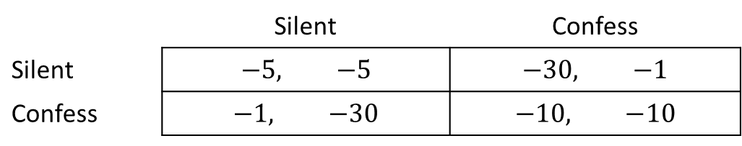
The Prisoner’s Dilemma: Repeated Finitely
Clyde
 | Silent | Confess
Silent | $$−5, −5$$ | $$−30, −1$$
Confess | $$−1, −30$$ | $$−10, −10$$
Bonnie
Suppose the prisoner’s dilemma was played not just once, but for a finite number of periods, say 3 periods.
Players can now observe the outcomes in earlier rounds and condition their actions on them.
When making their decisions, they consider the sum of their current and future payoffs.
What will the outcome then be?

Slide 45
The Prisoner’s Dilemma: Repeated Finitely
Extensive Form
S
S
C
C
S
S
C
S
Using backward induction, we can get the NE in the Period 3 subgames, then Period 2 subgames, and finally Period 1 subgames.
S
C
S
C
C
S
C
@ t=3
S
-5,-5
-30,-1
-1,-30
-10,-10
NE in Period 3 is (C,C)
Payoff from Period 3 subgames always (-10, -10)
S
S
C
C
C
S
Period 3
C
C
S
@ t=2
S
C
S
-5,-5
-30,-1
-1,-30
-10,-10
-10, -10
-10, -10
-10, -10
-10, -10
S
C
+
NE in period 2 is (C,C)
Payoff from Period 2 and 3 subgames always (-20, -20)
C
S
C
C
S
C
Period 1
Period 2
P 3
Period 2
Period 3

Slide 46
S
-5,-5
S
C
@ t=1
-20,-20
C
S
S
C
S
S
C
-30,-1
S
C
-20,-20
+
C
S
C
NE in period 1 is (C,C)
Payoff from Periods 1, 2 and 3 overall subgame is (-30, -30)
S
S
-1,-30
S
C
C
-20,-20
C
S
C
C
S
-10,-10
S
C
S
-20,-20
C
C
Period 1
Period 2
P 3

Slide 47
The Prisoner’s Dilemma: Repeated Finitely
At t = 3 (i.e., the game has already been played twice). Clyde and Bonnie should choose the dominant strategy, confess, as their actions are inconsequential.
At t = 2, Clyde and Bonnie each expect the other to confess in the next period, no matter what they do. Scenario is similar to being in the final round; both should choose confess.
At t = 1, Clyde and Bonnie each expect the other to confess in the next two periods, no matter what they do. Scenario is similar to being in the final round; both should choose confess.
The unique SPNE for this game is where they choose to confess in every period. This holds even if the game is repeated for a large, but still finite number of periods.
Why? With a unique NE, there will never be incentives starting from the penultimate period for people to behave well… This effect trickles down to the first period.
Takeaway: when there is a unique NE for the stage game, there will also be a unique SPNE for the finitely repeated game.

Slide 48
The Prisoner’s Dilemma: Repeated Infinitely
However, if the game is repeated for infinite periods, then the game has a huge number of credible subgame perfect NE — provided individuals value the future enough.
The efficient outcome (Silent, Silent) in every period is a result of one of these SPNE and it is sustained by grim trigger punishments.
If I observe confessions in any past period, I will confess forever after, otherwise I will stay silent.
The general idea here is that since in infinite games, there is always a future where a player can punish the other for not cooperating/reward the other for cooperating.
Takeaway: interacting (infinitely) often can potentially help us achieve welfare improvements.
Notes:
Notice that the statement “If I observe confessions in any past period, I will confess forever after, otherwise I will stay silent.” gives us a strategy for any possible history of the game in any period.

Slide 49
Key Learning Outcomes
Writing out the normal form for sequential games.
Understand why the concept of Nash Equilibria is not adequate enough for sequential games.
Understanding the concept of Subgame Perfect Nash Equilibria and solving for it.
Simple sequential games
Hybrid sequential games
Repeated games

Slide 50
Readings
Varian Chapter 29
Varian Chapter 30 (optional)
Osborne, An Introduction to Game Theory (optional): A game theory reference textbook
Osborne and Rubinstein, A Course in Game Theory (optional): A game theory reference textbook
Other articles (optional)
Game Theory in Economics and Beyond
Game Theory and the First World War

